Slide 1
Certification in Advanced Tech Service Engineering
Automation Case Study
TSE Advanced Batch 2
Atul Pahlazani
21-Sep-23

Slide 2
Plan
Automation overview
Introduction to case study
Case study solution design
Case study solution implementation
Learnings & enhancements

Slide 3
Automation overview
Automation in this era of technological advancement, used to solve boring and repetitive tasks.
Automation is the application of technology, programs, robotics, or processes to achieve outcomes with minimal human input.
It involves the use of technology to perform tasks with minimal human intervention. Automation can be applied in various domains such as business process automation, IT automation and consumer applications such as home automation.
In Retail Industry, by leveraging automation technologies such as electronic shelf-edge labels, self-checkout terminals, shelf-scanning robots, and partially automated backroom unloading, retailers can significantly reduce labor hours while improving operational efficiency.
In Walmart, in the Market fulfillment centers (MFC), Alphabots using autonomous carts to retrieve ambient, refrigerated and frozen items ordered for online grocery. After it retrieves them, Alphabot delivers the products to a workstation, where a Walmart associate checks, bags and delivers the final order.

Slide 4
Introduction to case study
In this case study, we prepare ourselves to solve the problem faced frequently in IT operations industry i.e., to automate the incident report.
In day-to-day operations, other than solving the actual issues that are reported, we must analyze the raw data, repeating every month or week.
This helps us in gathering meaningful data, with with we can streamline, finetune and improve existing process.
At my workplace, specifically in our operations team, this automation would solve manual analysis and report generation.
It helps to optimize out operations reporting and improve overall efficiency, minimizes the risk of human error and can handle increased data analysis without a proportional increase in labor requirements.
By automating these tasks, report automation tools free up employees’ time to concentrate on actual technical issues.
Overall, this can achieve increased efficiency and accuracy while minimizing operational expenses.

Slide 5
Case study benefits
In this case study, we work with the provided log incident data and design an Automation solution.
We collect data from the end user and analyze the total tickets that have been received per day, total tickets has been ‘Assigned’, total tickets has been marked as ‘Completed’, total tickets have been retained as ‘Pending’, total tickets have been retained as ‘Work in Progress’ and are ‘Unallocated’.
This is called as Report automation, which is the process of creating and delivering custom reports throughout an organization.
This allows us to have full control over the reporting system and customize reports based on needs and requirements and makes it easier to analyze data and identify trends or patterns.
UiPath as a tool is easier to use and don’t require programming skills for setting up reporting functionalities.

Slide 6
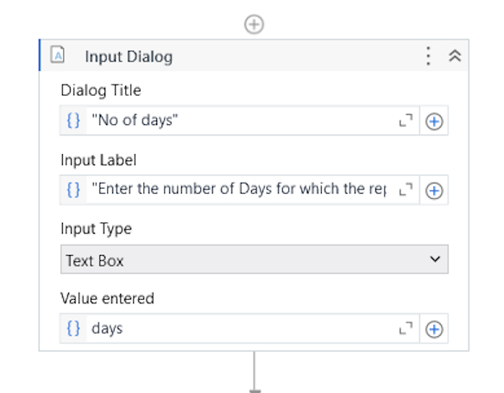
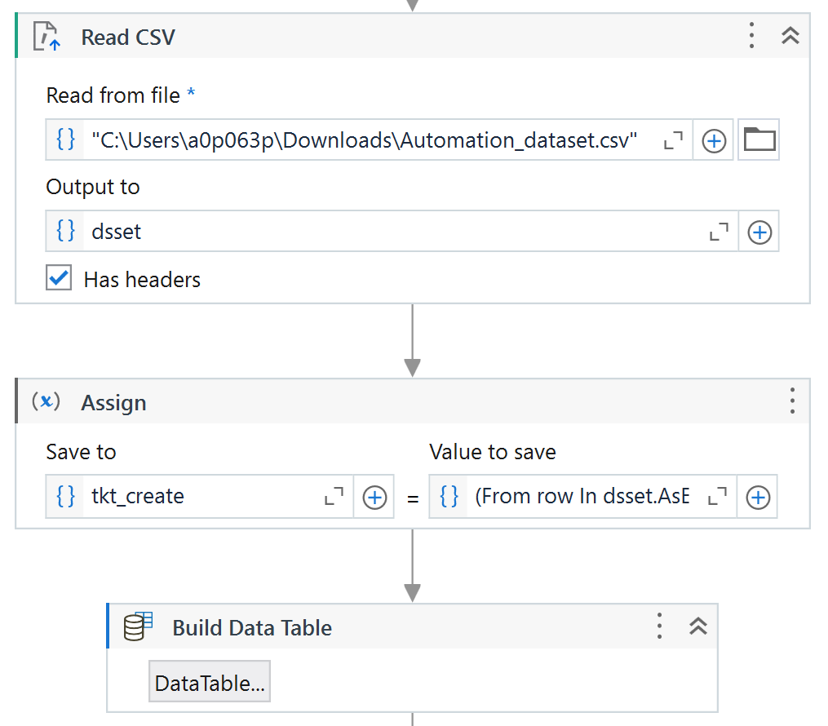
Case study solution design
As specified in the case study, we use UiPath and Python to solve this.
Input is received in UiPath and the dataset is processed.

Slide 7
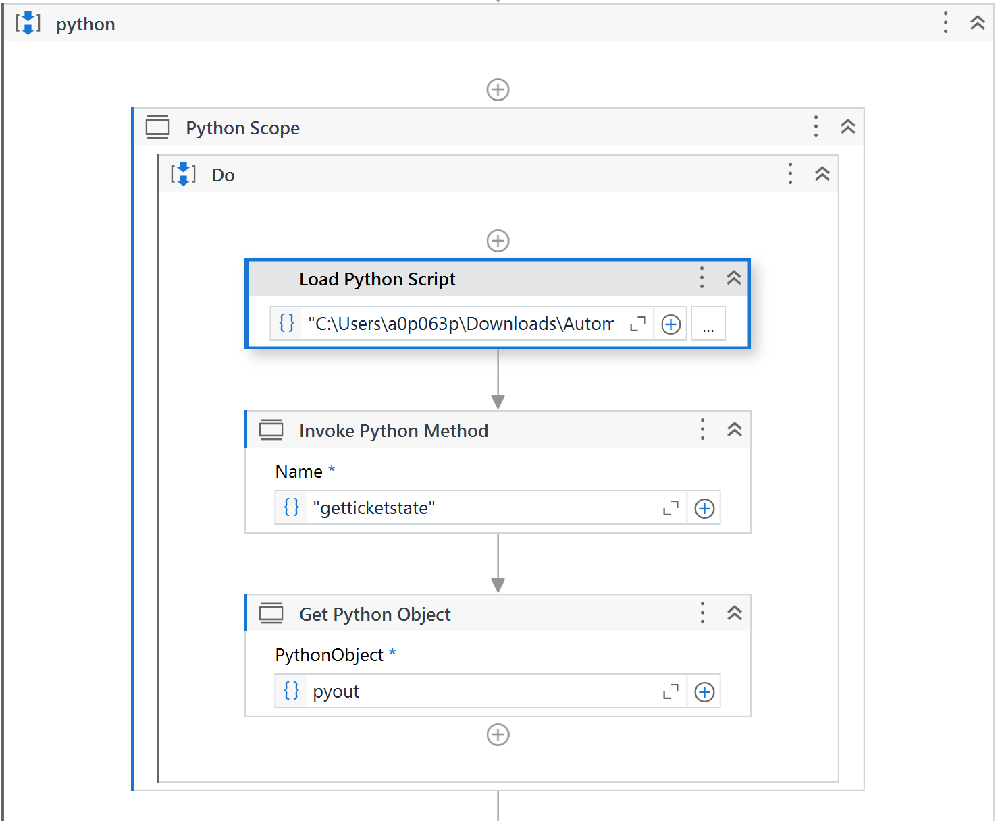
Case study solution implementation
Python script is called inside uipath within python scope.
The script is loaded and the method in called. In background the dataset is processed.

Slide 8
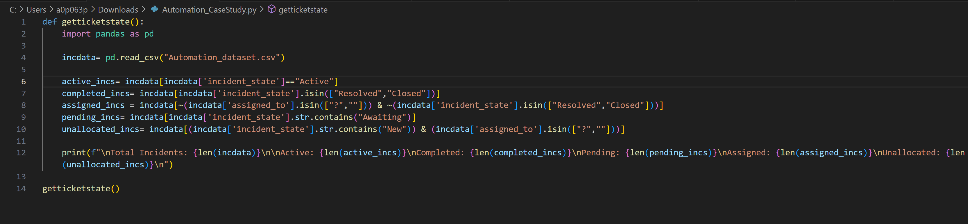
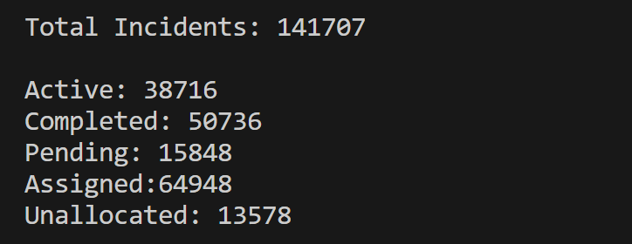
Case study solution implementation
Python Code

Slide 9
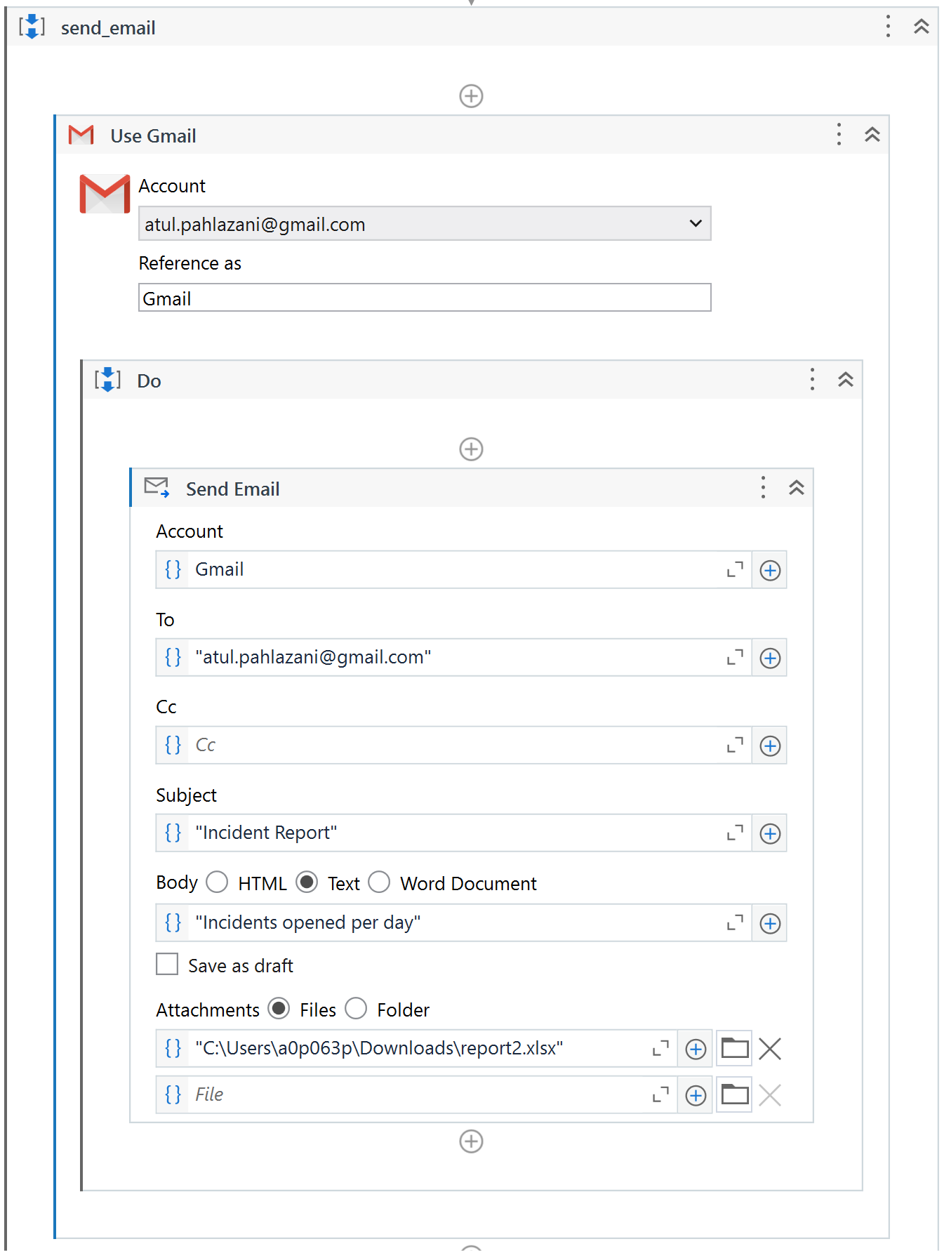
Case study solution implementation
Once python section is completed the report is sent using the ”Use Gmail” activity.
We must authorize and authenticate our email while doing the first time.
We specify the subject and path of the report that must be attached.

Slide 10
Learnings & enhancements
I learnt several integrations that can be done between various tools such as UiPath, python, Excel and Gmail.
Had to check the available list of activities for each tool. This exploration will help in future as well for other projects as well.
This integration with various programs, platforms, and databases, enabling smooth automation across different systems. This platform-agnostic approach allows organizations to automate processes regardless of the underlying technology stack.
This flexibility empowers developers to capture all their automation opportunities and deploy both UI and API integrations within a single automation.

Slide 11
What has been your manager’s feedback
My Manager was glad that the case study is a great example of how automation can help businesses improve their operations and customer satisfaction.
He is also supportive for the implementation of such automation in our team to increase efficiency, accuracy and save time.

Slide 12
Thank You

